Slide 1
GREAT LEARNING ACADEMY
BUSINESS REPORT
FROM
POOJA S

Slide 2

QUESTION 1
In the excel part I have create pivot table
I had taken in pivot fields columns as personal loan drag n drop, values as a sum of id drag n drop, left click on sum of id go to summarize the value field by count and ok.
So the pivot table reflects as count of id the bank customer without availed personal loans 90.40% ,The bank customer as availed personal loan 9.60%, the grand total is 100%
The conclusion is the bank customers as availed personal loan 9.60% with in 100%
Observation is out of 5000 customers only 480 customers have availed the personal loan

Slide 3
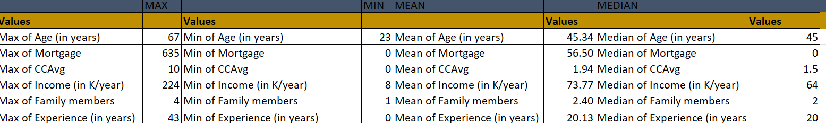
QUESTION2
The above table is create a pivot table say as value I did with the max n min in a pivot table and I separately calculated
The mean and median value below are observation
maximum age of 67 has 30+years of experience in range they have 40+ years experience in years and minimum of age is 23 0 to 10 years of experience in range they have 1+ years experience in years and average of customer in year 45 and median would say the same as average 45
in mortgage refers that 635 maximum value which is the experience 13 years 37 years in age there is overall average is 56.50 there is 0 in median
max of cc avg is 10 value is there is no minimum value the overall average is 1.94 median as 1.5
max of income is 224 is 48 yaers in age experience in range 21 - 30 years which is of experience is 24 years there is overall mean is 73.77 and median has 64
max of family members are 4 and minimum of member is 1 overall average is 2 and median has 2
maximum experience as 43 years minimum as 0 mean and median has both 20 with in average and mid value is 20

Slide 4
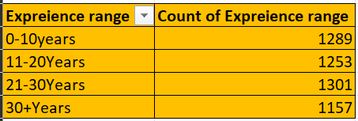
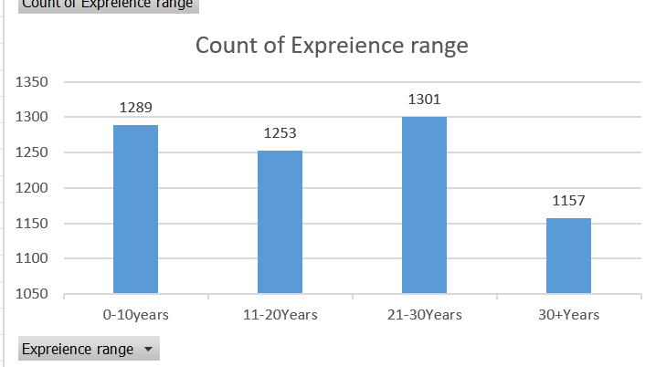
QUESTION 3
The above pivot table and pivot chart create and insert the value I got my observation below
As per my observation the maximum experience range is 21-30 years of age are
experienced which is the count of experience range is 1301 experienced persons

Slide 5
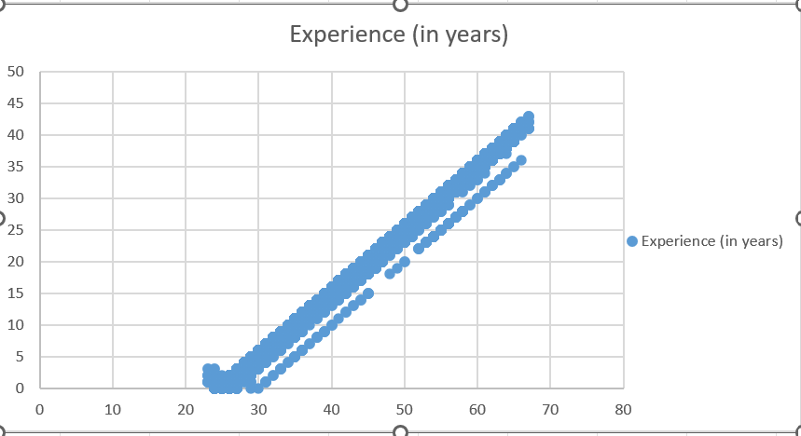
QUESTION 4
The above chart is explain about that how age and experience is correlated with each other the observation below
As per above chart age and experience both positively correlated with each other in the sense which is more aged person as more experienced persons so they are highly correlated

Slide 6
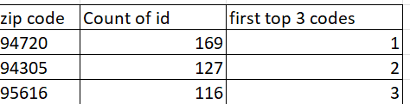
QUESTION5
The beside table shows about zip codes
the top 3 zip code where the bank customer's located are 169,127,119 ID are the top 3 codes

Slide 7
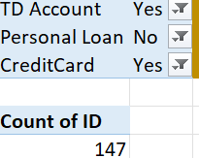
QUESTION6
The above pivot table interprets the below observation
As per pivot table the combination of fixed deposit and credit card is 147 ID are combined

Slide 8

QUESTION 7
The above table refers to interpretation of the personal loan with the calculation of mean and median
the customer with personal loan availed the median which is of 142.5 so the median has more accurate in personal loan

Slide 9
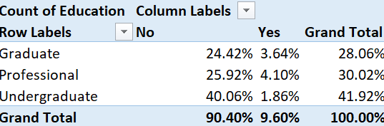
QUESTION8(a)
in the above pivot table professional person had availed personal loan is 4.10% they have working experience when compared to others because they have availed personal loan

Slide 10
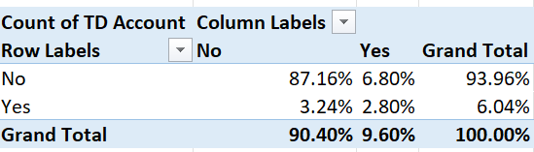
QUESTION8(b)
in the above table fixed deposit customer had availed personal loan 6.80% so they availed both fixed deposit and personal loan

Slide 11
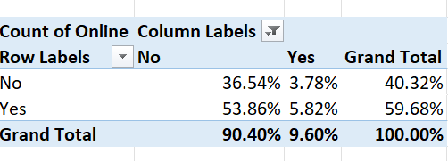
QUESTION8(c)
the above table refers to in online the personal loan availed is 5.82 %

Slide 12
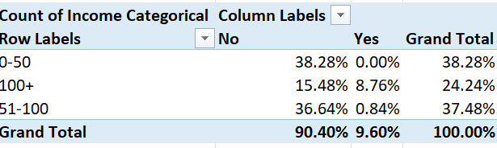
QUESTION8(d)
the above table says that 100+ had availed personal loan is 8.76% when compared to others

Slide 13
QUESTION 9
This question is refers to 4 pivot table and we need analyze and incur our observation so below is my observation
The mostly like to personal loan are the income categorical who has 100+ income which are availed to take the personal loan because they are professionally stable because they the percentage of 8.76% user of personal loan when compared to others y the users are more because they more aged person and as well they have more experience they have certain rules to be followed they have capacity of paying on time the loan they have limited family members these are my observation

Slide 14
QUESTION 10
if we want to availed customer to buy a personal loan there are certain points
Firstly we need to collect data from the last campaign demography, credit score, income from bank customer database
We need to identify mostly to incur the personal loan we need to search for them
We need to create own website and capturing through the sign up forms & building your blogs and exploring offers in social media pages quora, reddit etc
Digital marketing running through google showing in pop up ads and exploring in all search engines youtube showing ads in particular platform
In online loan markets showing ads these includes bank bazzar, apna pisa, loan circle, rupee power they may help to the customers view loan in different vendors with complete information at one place they may offer advertsing option to take up the loans from customer who ae willing
Reducing the interest level when compare to other banks for example if other bank gives loan for 10% interest you may reduce it to 8%
Get rid of unnecessary expenditure
Reference from current employers

Slide 15
Document verification should be bit faster do sanction the personal loan then customer will come automatically to apply loan
Network in tie up with communities, club, societies, small finance banks ect
Reduce overheads
Proper strategies to be used to talk with the customer to apply for loan example don’t be rude ,should not hesitate to talk with customer there should be always open talk with customer
Your needs n your requirements as within time period. that'all these are my strategies to availed the personal loan from customers .

Slide 16
THANK YOU

